Slide 1


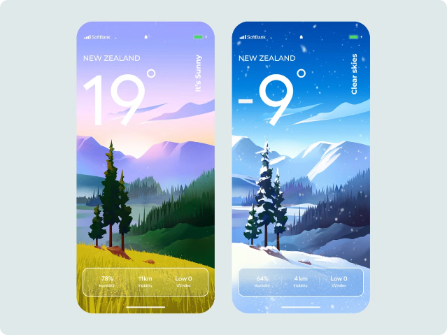
Weather Detection Application
INTRODUCTION
This weather detection application provides accurate and up-to-date information about the weather in your local area and around the world. With a user-friendly interface and customizable features, you can stay informed and prepared for any weather conditions.
G.SHANTHI RANI(192210129)
M.SHIVANI REDDY(192210275)

Slide 2
Weather Detection Application
Real-Time Data
Detailed Forecasts
Severe Weather Alerts
Our app uses the latest weather sensors and satellite data to provide real-time updates on current conditions.
Get accurate forecasts for the next 7 days, including temperature, precipitation, wind, and more.
Stay safe with immediate notifications for severe weather events like storms, floods, and extreme temperatures.

Slide 3

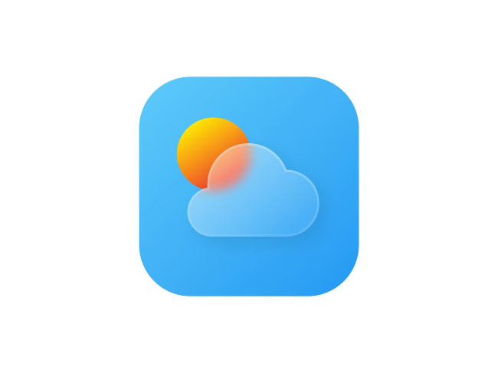
Key Features
1
Intuitive Interface
Our app is designed with a clean, easy-to-navigate interface that makes it simple to access the information you need.
2
Customizable Settings
Personalize your experience by setting location preferences, notification settings, and more.
3
Historical Data
View past weather patterns and trends to better understand the climate in your area.
4
Integrated Maps
Interactive weather maps help you visualize the current conditions and forecast across the globe.

Slide 4

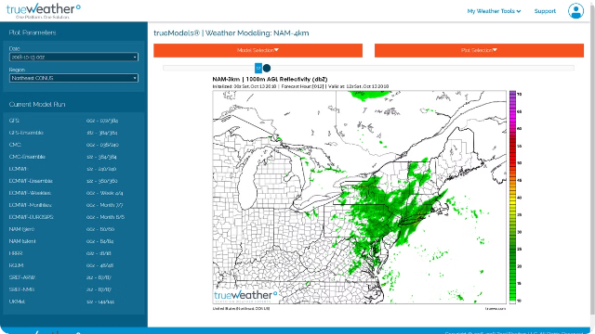
Accurate Forecasting
1
Data Collection
Our advanced weather sensors and satellite technology continuously gather data on atmospheric conditions.
2
Predictive Analytics
Sophisticated algorithms analyze the data to generate accurate weather forecasts for the days ahead.
3
Rapid Updates
The app is updated in real-time, so you always have the latest information on the weather.

Slide 5

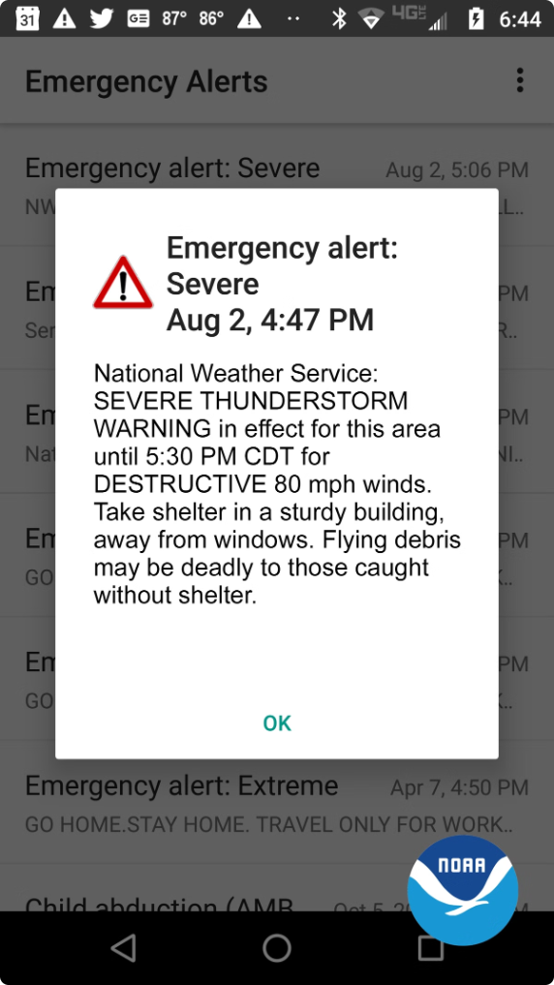
Real-Time Alerts
Severe Weather Warnings
Receive immediate alerts for severe storms, extreme temperatures, and other hazardous conditions.
Personalized Settings
Customize your alert preferences to ensure you're notified about the weather events that matter most to you.
Location-Based Monitoring
The app tracks your location and provides alerts specific to the areas you care about.
Multi-Channel Notifications
Get alerts through push notifications, email, and other channels to stay informed no matter where you are.

Slide 6
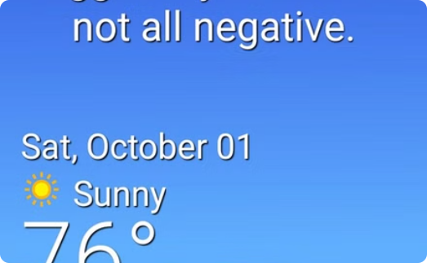
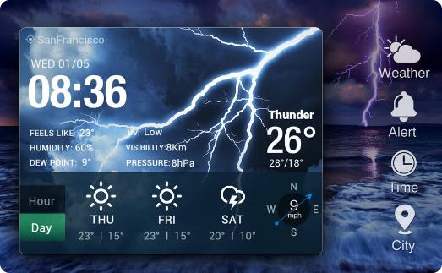
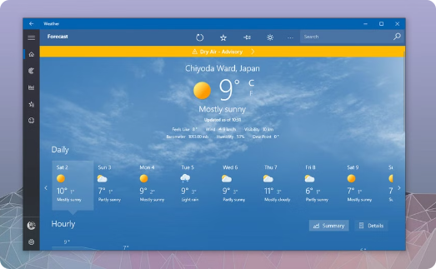
User-Friendly Interface
At-a-Glance Overview
Detailed Forecasts
Customizable Settings
The main dashboard displays the current weather conditions and forecast for your location.
Easily access hourly and daily forecasts to plan your day or week ahead.
Personalize the app to show the information that's most relevant to you and your needs.

Slide 7
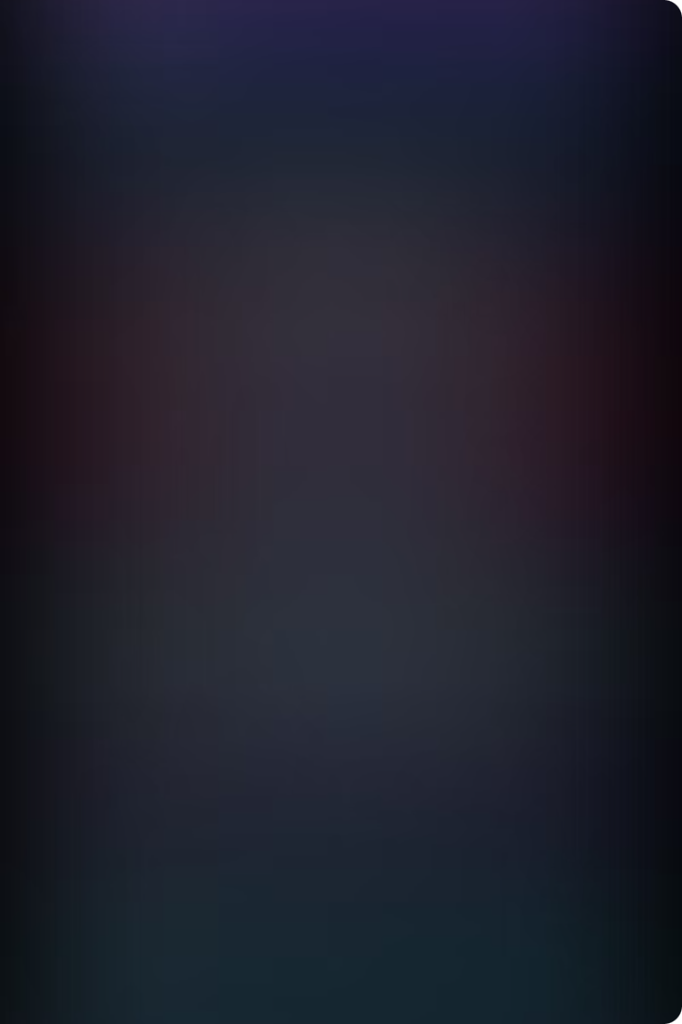
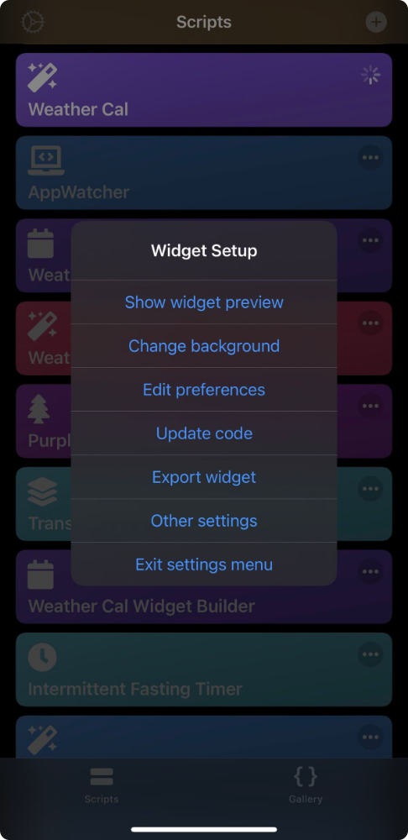




Customization Options
Location Settings
Temperature Units
Easily add, remove, and manage the locations you want to track.
Choose between Celsius, Fahrenheit, or Kelvin to display the units you prefer.
Alert Preferences
Appearance Settings
Customize the types of alerts and notifications you receive.
Adjust the app's theme, colors, and font preferences to match your style.

Slide 8

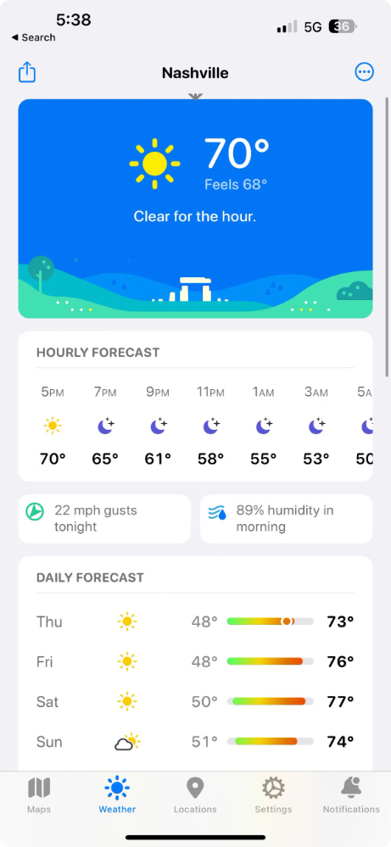
Pricing and Plans
Free
Basic weather information, limited location tracking
Premium
Detailed forecasts, severe weather alerts, unlimited locations
Enterprise
Custom branding, API access, advanced analytics
Explore our flexible pricing options to find the plan that best fits your needs and budget.

Slide 9
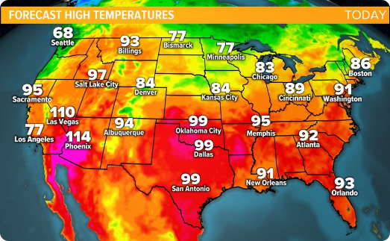
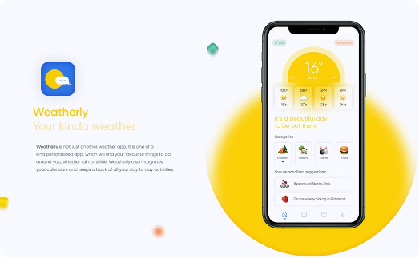
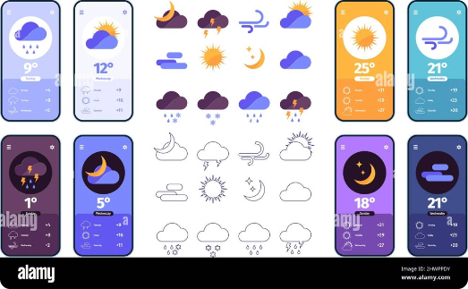
Comprehensive Weather Data
Personalized User Experience
Reliable and Accessible
Our weather detection app provides accurate, real-time information to keep you informed and prepared.
Customize the app to your preferences and receive alerts tailored to your specific needs.
Stay connected to the latest weather updates anytime, anywhere with our user-friendly mobile app.

Slide 10

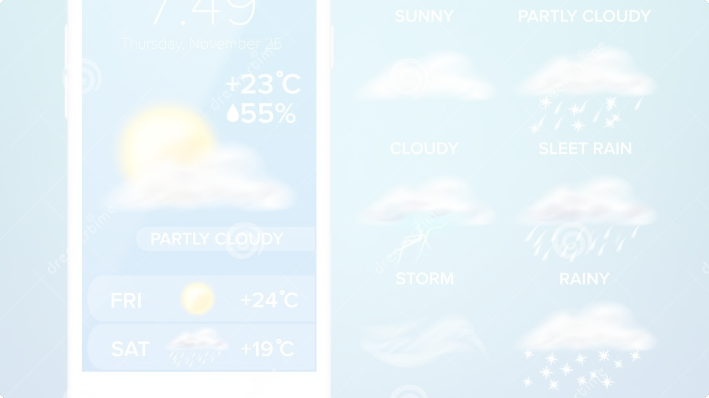
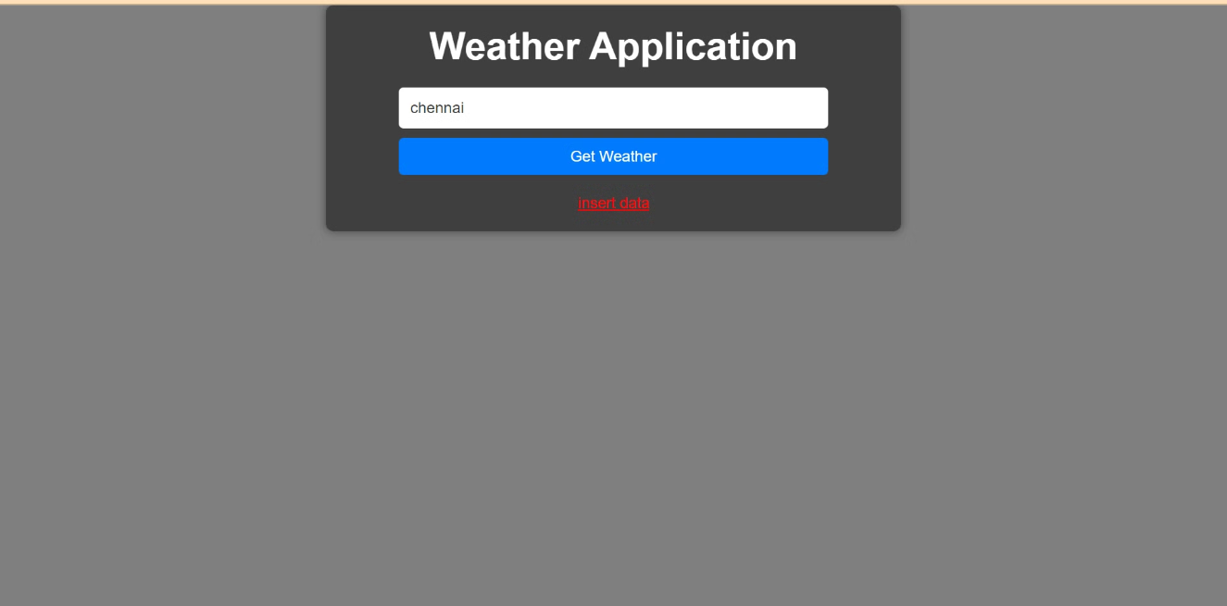
output:
Stay informed and prepared with real-time weather alerts and forecasts.

Slide 11
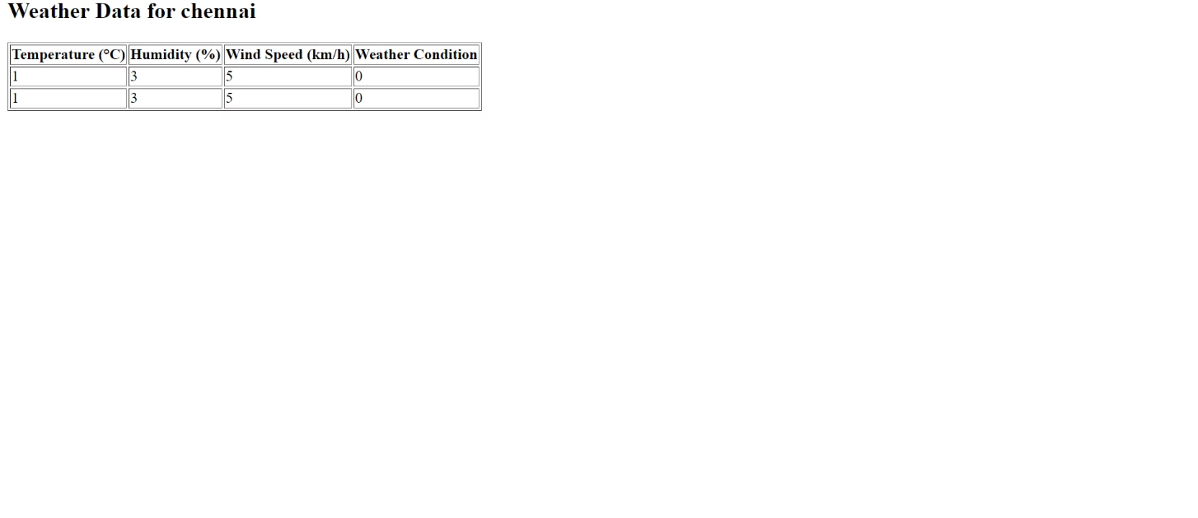
step2:

Slide 12

Software Used
Our weather detection application was developed using the following tools:
Chrome
XAMPP
Our web application is optimized for the Chrome browser, providing a smooth and responsive user experience.
The backend of our application runs on the XAMPP open-source web server solution, ensuring reliable and scalable performance.

Slide 13
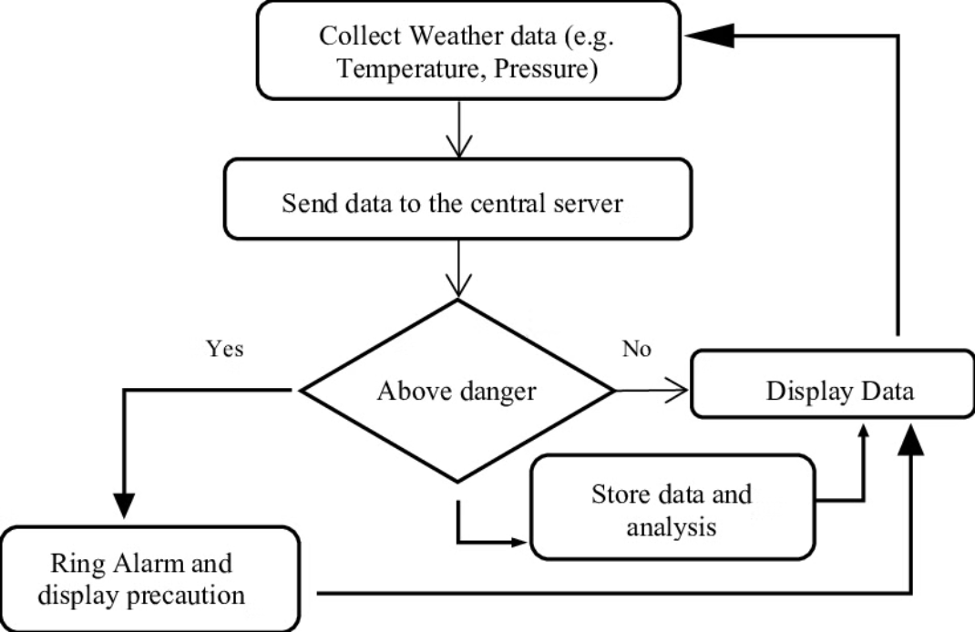
Flow chart:

Slide 14

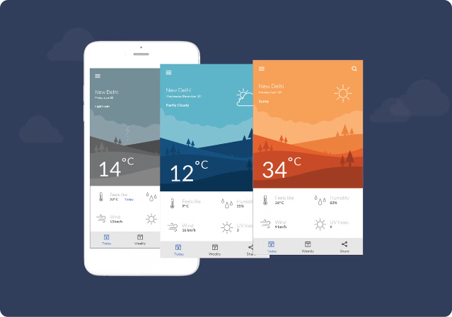
Conclusion
With our advanced weather detection application, you can stay one step ahead of the elements and make informed decisions to protect yourself and your loved ones. Download the app today and experience the ultimate in weather monitoring and preparedness.

